Slide 1
K-2 Math Strategies that work
Jennifer Meaker, First Grade Teacher
Marlo Baker, Second Grade Teacher

Slide 2
Standards Progression: Operations and Algebraic Thinking
First Grade | Second Grade
1.OA.3 Apply properties of operations as strategies to add and subtract. Examples: If 8 + 3 = 11 is known, then 3 + 8 = 11 is also known. | 2.OA.2. Fluently add and subtract within 20 using mental strategies By end of Grade 2, know from memory all sums of two one-digit numbers.
1.OA.4 Understand subtraction as an unknown-addend problem. For example, subtract 10 – 8 by finding the number that makes 10 when added to 8. Add and subtract within 20.
1.OA.5 Relate counting to addition and subtraction (e.g., by counting on 2 to add 2).
1.OA.6 Add and subtract within 20, demonstrating fluency for addition and subtraction within 10. Use strategies such as counting on; making ten; decomposing a number leading to a ten; using the relationship between addition and subtraction; and creating equivalent but easier or known sums.
1.OA.7 Understand the meaning of the equal sign, and determine if equations involving addition and subtraction are true or false.
1.OA.8 Determine the unknown whole number in an addition or subtraction equation relating three whole numbers. For example, determine the unknown number that makes the equation true in each of the equations 8 + ? = 11, 5 = _ – 3, 6 + 6 = _.

Slide 3
Standards Progression: Numbers in Base Ten
First Grade | Second Grade
1.NBT.4 Add within 100, including adding a two-digit number and a one-digit number, and adding a two digit number and a multiple of 10, using concrete models or drawings and strategies based on place value, properties of operations, and/or the relationship between addition and subtraction; relate the strategy to a written method and explain the reasoning used. | 2.NBT.5. Fluently add and subtract within 100 using strategies based on place value, properties of operations, and/or the relationship between addition and subtraction.
1.NBT.5 Given a two-digit number, mentally find 10 more or 10 less than the number, without having to count; explain the reasoning used. | 2.NBT.8. Mentally add 10 or 100 to a given number 100–900, and mentally subtract 10 or 100 from a given number 100–900.
1.NBT.6 Subtract multiples of 10 in the range 10-90 from multiples of 10 in the range 10-90 (positive or zero differences), using concrete models or drawings and strategies based on place value, properties of operations, and/or the relationship between addition and subtraction; relate the strategy to a written method and explain the reasoning used.
 | 2.NBT.6. Add up to four two-digit numbers using strategies based on place value and properties of operations.
 | 2.NBT.7. Add and subtract within 1000, using concrete models or drawings and strategies based on place value, properties of operations, and/or the relationship between addition and subtraction; relate the strategy to a written method.
 | 2.NBT.9. Explain why addition and subtraction strategies work, using place value and the properties of operations.

Slide 5
First Grade
Single Digit Addition and Subtraction Strategies

Slide 6
Make a Ten with Addition
7+5=
To make a ten, you need to think about how much you need to add to 7 in order to make 10.
First you would write the 7 and count on with circles
7
When you count you can see that 7 and 3 more gives you ten. Next you just need to count on the last 2 circles to get your answer of 12.
You can also make a ten using a Ten’s Frame.
Draw a tens frame (A rectangle with a line going across the middle and 4 lines down) and add 7 red circles.
Then add three yellow circles from the 5 to fill up the tens frame. Finish adding the five circles in the next tens frame.
Now you can see that 10+2= 12 Just as 7+5=12.
https://www.youtube.com/watch?v=jJeu3jq8lsY&list=PLNDkuWRw1gGRpuFSgmHjf07KamFfjq8Gz&index=80

Slide 7
Counting On
5+3=
To count on, first you need to find the larger number in the equation.
For this equation it would be 5.
Next you put the 5 in your head and say 5.
Then you draw circle for the 3 and count on from 5
5
You count 5, 6, 7, 8. Now you know your answer is 8.
https://www.youtube.com/watch?v=dt5PewAy70A&index=88&list=PLNDkuWRw1gGRpuFSgmHjf07KamFfjq8Gz
https://www.youtube.com/watch?v=lz81gKV5e2I&list=PLNDkuWRw1gGRpuFSgmHjf07KamFfjq8Gz&index=87

Slide 8
Tens Frames with Addition
4+5=
To add using a tens frame, you first need to make a tens frame.
Then add 4 red circles.
Next add 5 yellow circles and count up how many circles there are all together.
https://www.youtube.com/watch?v=D4AWam_4OEc&list=PLNDkuWRw1gGRpuFSgmHjf07KamFfjq8Gz&index=79

Slide 9
Tens Frames with Subtraction
7-3=
First you will need to make a tens frame.
Put 7 red circles in the tens frame.
Then start at the last circle and cross out 3 circles.
Last count up the circles that are not crossed out and there is your answer.
https://www.youtube.com/watch?v=Rq6FPxSTwEs&list=PLNDkuWRw1gGRpuFSgmHjf07KamFfjq8Gz&index=125
X
X
X

Slide 10
Addition and Subtraction with a Number Line
6+3=
Make your number line. The start with the biggest number, which is 6.
Jump forward 3 numbers and you see you land on the number 9.
Circle the 9 and now you know that 6+3=9
6 7 8 9 10

Slide 11
Addition and Subtraction with a Number Line
7-2=
Draw a number line.
Start at your biggest number, which is 7.
Hop backwards 2 numbers.
Circle the number you land on and this is your answer.
Now you know 7-2=5
https://www.youtube.com/watch?v=NYew8NbQ33o&list=PLNDkuWRw1gGRpuFSgmHjf07KamFfjq8Gz&index=82
3 4 5 6 7

Slide 12
Math Mountain
8+4=
First you will need to make a math mountain (upside down V)
Then put the partners at the bottom of the mountain. The biggest number will go on the top of the mountain.
Next put the biggest number in your head and say it.
Then add circles (boulders) to the 4 side of the mountain and count on to find the answer.
12
8 4

Slide 13
Second Grade
Multiple Digit Addition and Subtraction Strategies

Slide 14
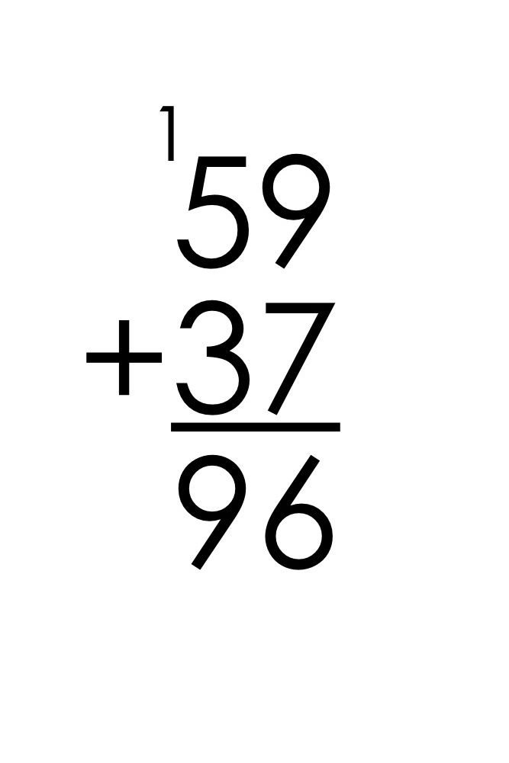
No more traditional algorithm! (at least not until 3rd grade)

Slide 15
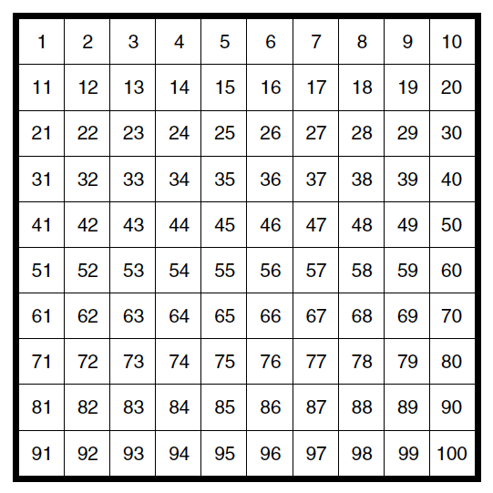
Hundreds Chart
2 tens and 3 ones
71
23 + 48 =
First you find the larger number on the hundreds chart.
Next you break apart the smaller number into its tens and ones.
Then you jump down the number line however many tens are in that number.
Last, you move across however many ones. The number you land on is your sum.
To subtract, you just work backwards from the larger number, jumping by tens and ones.

Slide 16
Number Line
2 tens 5 ones
67 + 25 =
92
First, determine the larger number and put it at the beginning of the open number line.
Next you break apart the smaller number into its tens and ones.
Then you jump across the number line however many tens you are adding, and count by tens as you go.
To subtract, start from the right with the larger number and jump backwards.
Last, you jump across however many ones. The number you land on is your sum.
+ 10
+ 10
+ 1
+ 1
+ 1
+ 1
+ 1
67
77
87
88
89
90
91
92

Slide 17
Number Line- three digit numbers
321 + 592 =
+ 100
+ 100
+ 100
+ 10
+ 10
+ 1
592
602
612
622
632
642
643

Slide 18
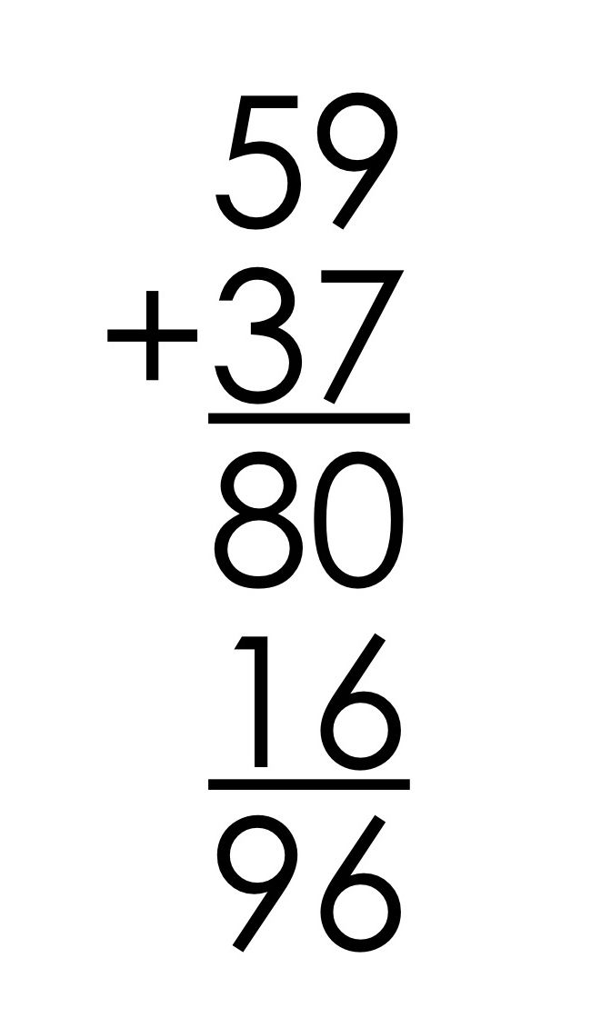
Expanded method
38 + 57 =
First you rewrite the problem so that it is vertical.
Next you expand the numbers out into their tens and ones. Be sure to expand your equals line as well.
Then you add the tens and the ones. It doesn’t matter the order.
Last, you add the tens and ones back together for your sum.
38
+57
= 30 + 8
= 50 + 7
80 + 15
= 95
*This is similar to mental math or “Show all totals”, but instead you add the tens and ones in your head and just record the sums of the part.

Slide 19
Expanded method- three digit numbers
238 + 657 =
238 = 200 + 30 + 8
+ 657 = 600 + 50 + 7
800 + 80 + 15= 895

Slide 20
Proof Drawing
25 + 47 =
72
First draw a “T” “O” chart. “T” represents tens, “O” represents ones.
Next, draw your place value pieces to represent the tens and ones from each number. Lines mean tens, circles mean ones.
Then, look to see if you can make a group of ten. If you can, circle it and add the ten to the “T” side of your chart.
Last, add up your tens and ones and you will find the sum.
T O
7 2

Slide 21
Proof drawing- three digit numbers
435 + 279 =
H T O
7 1 4

Slide 22
Now that you have been introduced…
Mental Math Strategy- Counting On Mental Math Strategy- Make a Ten Mental Math Strategy- Make an Easier Problem Mental Math Strategy- Using the relationship between addition and subtraction Using a number line to add or subtract Using a hundreds board to add or subtract Adding two digit numbers on a number line Adding two digit numbers using a hundreds board Show all totals method Adding using partner houses and math mountains
Adding three digit numbers using the expanded method Subtracting three digit numbers using the expanded method

